Slide 1
Databricks Training Guide
October 2023

Slide 2
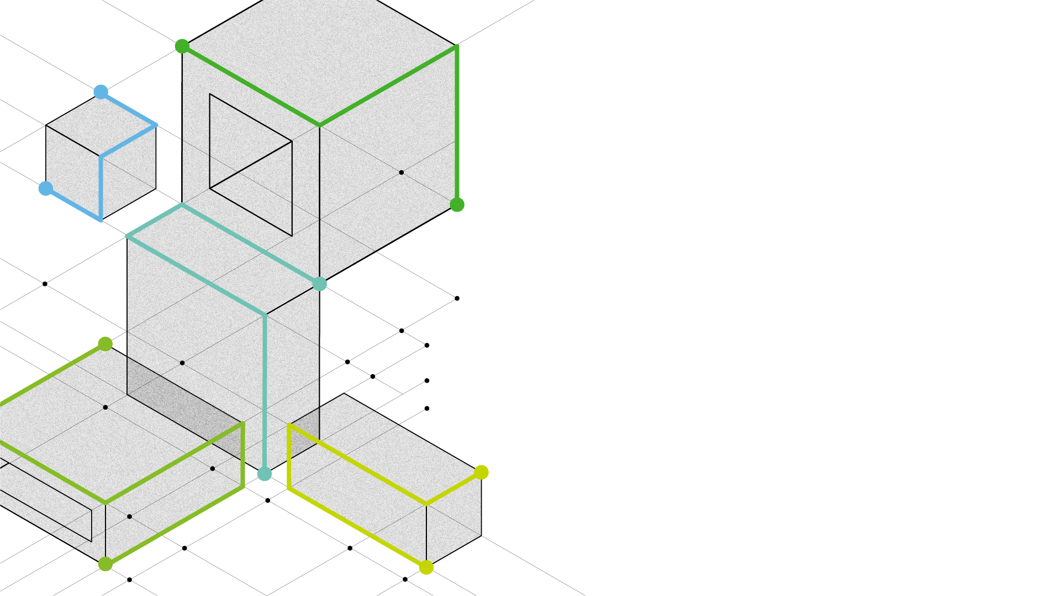
Validate your data and AI skills in the Databricks Lakehouse Platform by getting Databricks certified.
Whether you are new to business intelligence or looking to confirm your skills in data analysis, data engineering, or machine learning, Databricks can help you achieve your goals.

Slide 3
Table of Contents
1 Partner Portal Access
2 Training & Certification Pathways
4 Requesting Vouchers
Scheduling the Exam
FAQ’s, Support & Prerequisite Training

Slide 4
Partner Portal Access

Slide 5

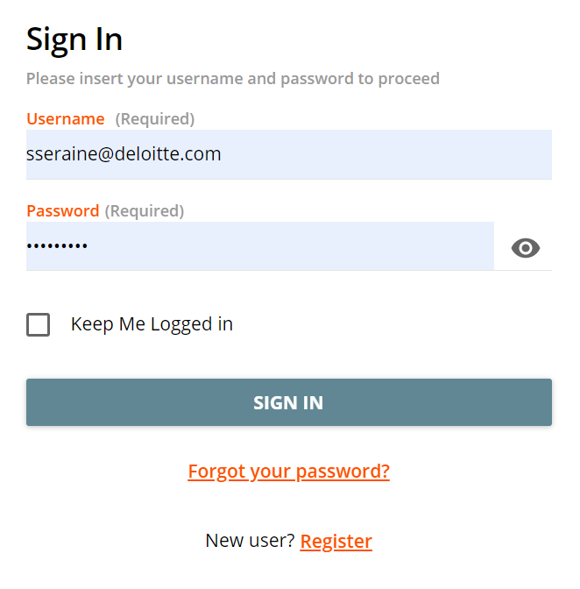
Partner Portal
Register on the Partner Portal to access the Databricks Partner Academy
Registration Instructions in the Partner Portal:
Enter your name and Deloitte email on the registration page
Find and click on the verification link sent to your email
Login and start learning!

Slide 6
Training & Certification Pathways

Slide 7

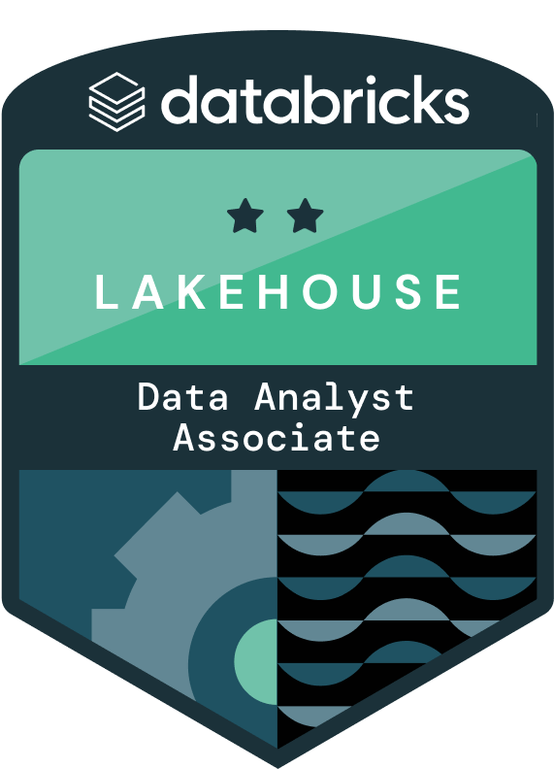
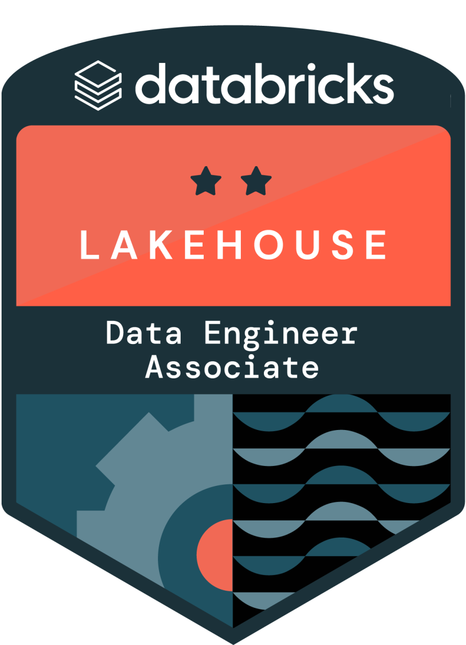
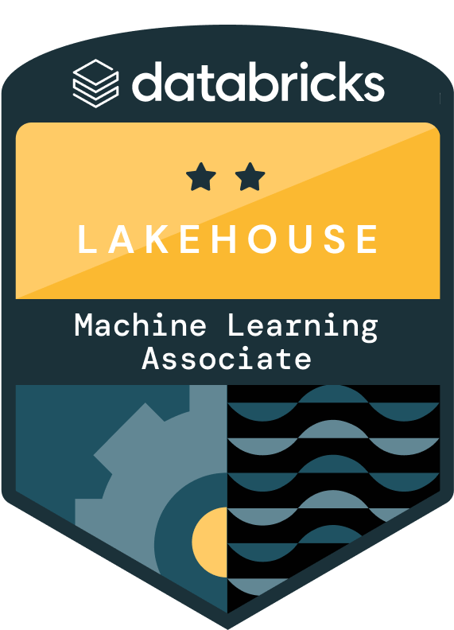
Partner Technical Learning Paths & Certifications
Associate Level Certifications
Databricks Partner Collab Environment Setup Form
*Certifications may be earned in any order
Certification | Course Description | Databricks Self-Study Training Course | Course Length | Role
Data Analyst Associate | Comprehensive introduction to Databricks SQL. Learners will ingest data, write queries, produce visualizations and dashboards, and configure alerts. | Data Analysis with Databricks SQL Certification Overview Exam Guide | 7 hours | Data Analyst transform data into insights by creating queries, data visualizations and dashboards using Databricks SQL and its capabilities
Data Engineer Associate | Comprehensive introduction to the components of the Databricks Lakehouse Platform that directly support putting ETL pipelines into production. | Data Engineering with Databricks V3 Certification Prep (ILT) Certification Overview Exam Guide | 15 hours | Data Engineers design, develop, test, and maintain batch and streaming data pipelines using the Databricks Lakehouse Platform and its capabilities.
Machine Learning Associate | Learn how to scale ML pipelines with Spark, including distributed training, hyperparameter tuning, and inference. Build and tune ML models with SparkML while leveraging MLflow to track, version, and manage these models. | Scalable Machine Learning with Apache Spark Certification Overview Exam Guide | 11 hours | ML Data Scientists develop, deploy, test, and maintain machine learning models and pipelines using Databricks Machine Learning and its capabilities.
Note: Free ELEVATE Instructor-led trainings (ILT) are available through Partner Academy in addition to self-study courses

Slide 8
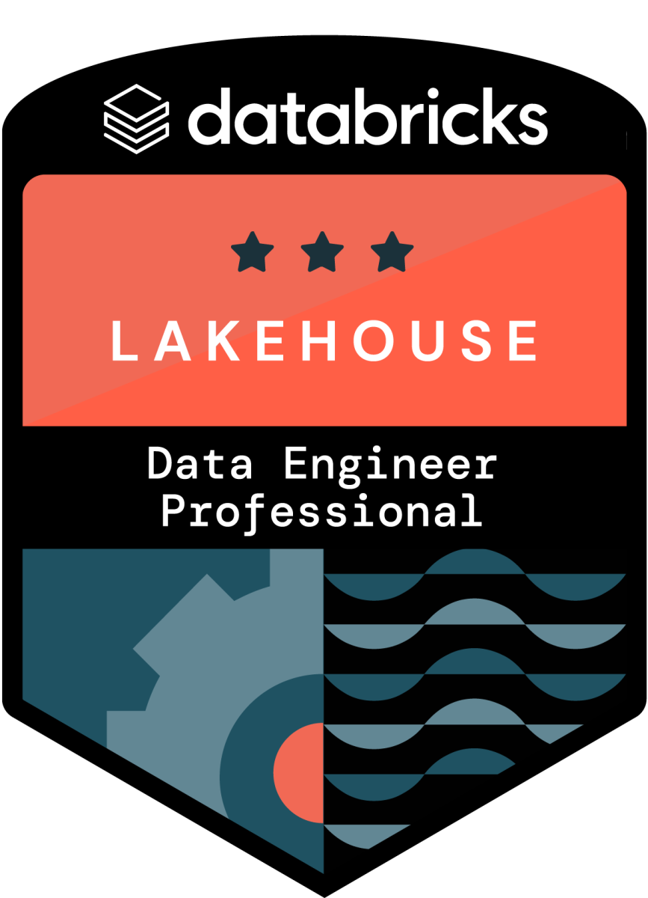
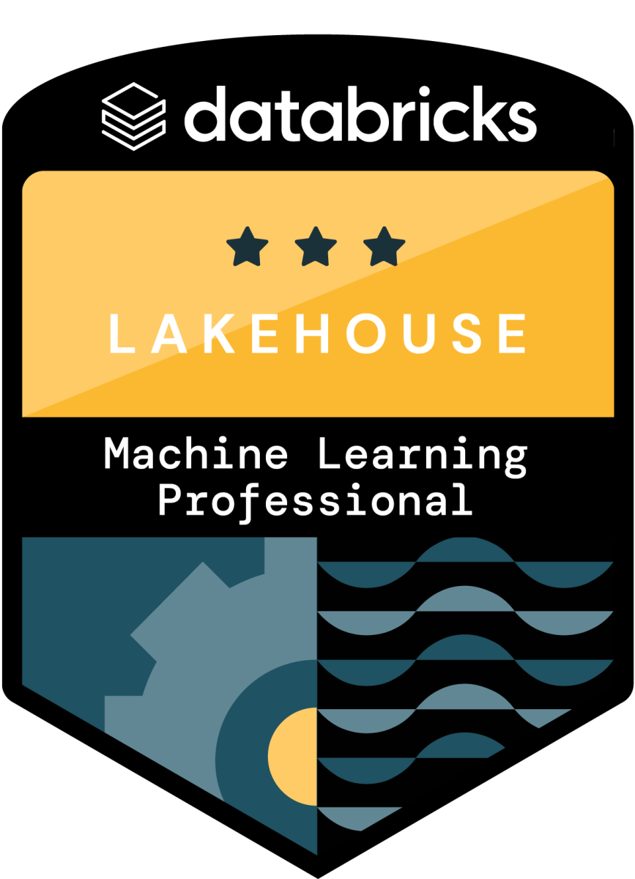
Partner Technical Learning Paths & Certifications
Professional Level Certifications
Databricks Partner Collab Environment Setup Form
*Certifications may be earned in any order
Certification | Course Description | Databricks Self-Study Training Course | Course Length | Role
Data Engineer Professional | Learners will build upon their existing knowledge of Apache Spark, Structured Streaming, and Delta Lake to unlock the full potential of the data lakehouse by utilizing the suite of tools provided by Databricks. *Updated course being released in August | Advanced Data Engineering with Databricks Certification Overview Exam Guide | 13 hours | Data Engineers design, develop, test, and maintain batch and streaming data pipelines using the Databricks Lakehouse Platform and its capabilities.
Machine Learning Professional | Focus on managing ML experiments and models with Mlflow through two main course components: (i) using MLflow to track the ML lifecycle, package models for deployment, and manage model versions (ii) examining various production issues, different deployment paradigms, and post-production concerns. | Machine Learning in Production Certification Overview Exam Guide | 9 hours | ML Data Scientists develop, deploy, test, and maintain machine learning models and pipelines using Databricks Machine Learning and its capabilities.
Note: Free ELEVATE Instructor-led trainings (ILT) are available through Partner Academy in addition to self-study courses

Slide 9
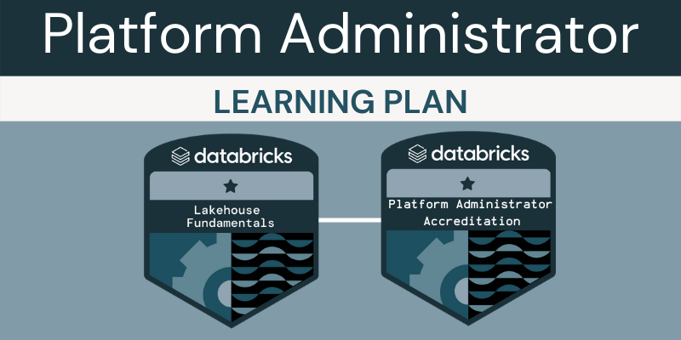
Partner Technical Learning Paths & Accreditations
Accreditations
*The recommended prerequisite is Fundamentals of the Databricks Lakehouse Platform and Accreditation
Accreditation | Course Description | Databricks Self-Study Training Course | Course Length | Role
Platform Administrator | Topics within this cloud-neutral path are relevant across all three Databricks clouds (Azure, AWS, and Google Cloud) and are organized into the following courses: Databricks Platform Administration Fundamentals Databricks Identity Administration Databricks Workspace Administration and Security Databricks Compute Resource Administration Data Administration in Databricks CI/CD Administration in Databricks Databricks Accredited Platform Administrator Accreditation | Platform Administrator Learning Plan | 5.75 hours | The platform administrator is responsible for managing and maintaining the platform, as well as guaranteeing its security and providing support to its users. Their responsibilities encompass the technical, operational, and security areas, ensuring that the platform runs smoothly and meets the expectations of its users.

Slide 10
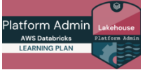
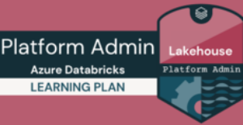
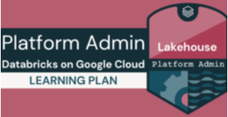
Partner Technical Learning Paths & Accreditations
Accreditations
*The recommended prerequisite is Fundamentals of the Databricks Lakehouse Platform and Accreditation
Accreditation | Course Description | Databricks Self-Study Training Course | Course Length | Role
Platform Administrator – AWS Databricks | Under Development | Platform Administrator – AWS Databricks Learning Plan | 5.5 hours | The Platform administrator AWS Databricks is responsible for managing and maintaining the AWS – Databricks platform, as well as guaranteeing its security and providing support to its users
Platform Administrator – Azure Databricks | Under Development | Platform Administrator – Azure Databricks Learning Plan | 7.75 hours | The Platform administrator- Azure Databricks is responsible for managing and maintaining the Azure – Databricks platform, as well as guaranteeing its security and providing support to its users.
Platform Administrator – Google Cloud Databricks | Under Development | Platform Administrator – Google Cloud Databricks Learning Plan | 5.25 hours | The Platform administrator- GCP Databricks is responsible for managing and maintaining the GCP – Databricks platform, as well as guaranteeing its security and providing support to its users.

Slide 11
A Journey to GenAI Mastery
A step by step approach
Accreditation | Course Description | Databricks Self-Study Training Course
Level 1 – Prompt Engineering | To start your GenAI journey, use prompts to control language models (LLMs) in a Databricks workspace with Unity Catalog for a strong foundation. Databricks also provides MLflow AI Gateway for secure LLM access. You can select proprietary or curated open-source generative AI models, serve them using GPU Serving, and fine-tune prompts with AI Functions. To get started, explore Unity Catalog and complete the GenAI Fundamentals course in the Partner Academy. All you need is a Unity Catalog-enabled Databricks workspace to begin, and you can apply these techniques to different data-driven use cases, starting with the Dolly Chatbot sample code. | Training and Content Unity Catalog GenAI Fundamentals Lakehouse AI Capabilities AI Gateway Curated Models AI Functions GPU Serving Sample Content Build your Chatbot with Dolly
Level 2 – Retrieval Augmented Generation (RAG) | In the next phase of your GenAI journey, transition from public data to domain-specific information using Retrieval Augmented Generation (RAG) with Databricks Vector Search for efficient data indexing. Orchestrate the process with LangChain, integrating proprietary and open-source LLMs. Consider MosaicML Inference starter tier for reliable endpoints when serving open-source models. Start with the RAG chatbot demo and personalize it with your own domain-specific datasets. | Training and Content Lakehouse AI Capabilities Vector Search Infrastructure MosaicML Inference Sample Content RAG Chatbot w/Vector Search and Llama-2

Slide 12
A Journey to GenAI Mastery
A step by step approach
Accreditation | Course Description | Databricks Self-Study Training Course
Level 3 – Fine – tune Open Source Gen AI Models | After mastering RAG applications, you can further customize by fine-tuning models with proprietary data and explore AutoML for text classification and embedding fine-tuning using your Lakehouse data. At this stage, leverage additional Lakehouse AI capabilities for model creation, registration, serving, and production monitoring. Databricks offers the course "LLMs - Applications through Production" for in-depth knowledge. For infrastructure, a small MosaicML training cluster suffices for fine-tuning, while the rest can be managed within your Databricks workspace. Begin with the sample "Fine-tuning MPT-7b for SEC Form 10-K" and adapt it with your datasets, or choose a different open-source base model as a starting point. | Training and Content LLMs – Applications Through Production Lakehouse AI capabilities: Auto ML w/ LLMS Model Registry Feature Eng Feature Services Monitoring Assistant Infrastructure MosaicML Training (Small) Sample content Fine-tuning MPT-7b for SEC Form 10-K
Level 4 – Train your own GenAI Models (Using your Proprietary Data) | In the final stage of mastering GenAI, you'll create your own models from scratch using proprietary data. Explore Lakehouse AI's MLOps Stacks for dependable GenAI deployments. Consider taking the "Foundation Models From the Ground Up" course at Partner Academy to learn how to build your own GenAI models. For large-scale model training, you'll need access to a substantial MosaicML cluster with hundreds of GPUs. Collaborate with our expert team for a successful "hero run" to guide you through this advanced process. | Training and Content Foundation Models From the Ground Up Lakehouse AI Capabilities: Sharing Models MLOps Stacks Inference Tables Model Lineage Infrastructure: MosaicML Training (Large)

Slide 13
Requesting Exam Vouchers

Slide 14
Requesting Exam Vouchers
Please Note: Vouchers may only be used with a Deloitte email - Do not use a personal email address
Follow the steps below
5
4
Schedule and take your exam using your voucher. Share your results with Databricks Alliance Training Team
3
Include the following information with your request:
Certification Name
Training Completion Date/Course Name
Date you plan to take exam
Deloitte Offering
2
For Subject, please type “Databricks Certification Voucher Request”
1
Email voucher request to Databricks Alliance Training Team
Complete required training and certification prep course.

Slide 15
Scheduling the Exam

Slide 16
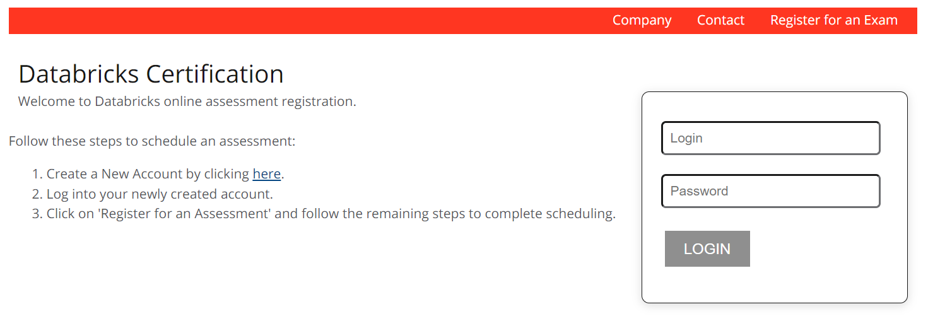
Scheduling Your Exam
In order to achieve a Databricks certification, earners must pass a certification exam.
To schedule your exam, please either log in or create an account in the Databricks Certification Platform.
here
*Vouchers may only be used with a Deloitte email - do not use a personal email address

Slide 17
FAQ’s, Support & Prerequisite Training

Slide 18


FAQ’s and Technical Support
Term | Definition
Trained | Completed a Databricks course. Can be in-person or eLearning.
Badge | Awarded upon successful completion of a Databricks assessment. Databricks provides two forms of assessments: accreditation, and certifications.
Accreditation | Non-proctored, non-technical assessment. Can be taken in Databricks’ LMS.
Certification | Awarded upon successful completion of a proctored technical assessment that is aligned directly with a Databricks technical course. Certifications are provided via 3rd party proctor for which partners are to pay an at-cost fee of $50 per attempt. *One free voucher may be provided for your first exam attempt. *Subject to availability
For frequently asked questions (FAQ’s), please refer to Databricks Academy FAQ document.
For any concerns/issues on the Partner Academy please submit a support ticket here.

Slide 19
Databricks Certification Prerequisite Training & Accreditation
Recommended foundational courses
Prerequisite | Course Description | Databricks Self-Study Training Course | Course Length
Fundamentals of Databricks Lakehouse Platform Training | Conceptual introduction to what Databricks is, how it relates to the day-to-day work of data teams, and the components that make up the Databricks Lakehouse Platform. | Fundamentals of Databricks Lakehouse Platform | 1 hour
Databricks Lakehouse Fundamentals Accreditation | The assessment will test your knowledge about fundamental concepts related to the Databricks Lakehouse Platform. Questions will assess your knowledge about the platform in general, including your ability to identify how the platform helps organizations accomplish their data workloads. After successfully completing this assessment, you will be awarded a Databricks Lakehouse Fundamentals badge. | Databricks Lakehouse Fundamentals Accreditation Exam | 20 minutes
Generative AI Fundamentals | This course provides an introduction to how organizations can understand and utilize generative artificial intelligence (AI) models. | Generative AI Fundamentals | 2 hours

